Slide 1
Final Project AIDI 1012 - Artificial Intelligence Robotics and Automation Alireza Ghaffari August 18, 2022
Topics:
Team Members:
Data Collection
Road Following
Collision Detection
Object Following
Challenges Faced
Brijesh V Kuvadiya
Harshit Bhatia
Deepak Sardana
Jasmeet Singh Sikhand

Slide 2
01
Data Collection
We took 700 images for “Collision Avoidance” (with/without collision) and “Road Following” models for our Training Dataset

Slide 3
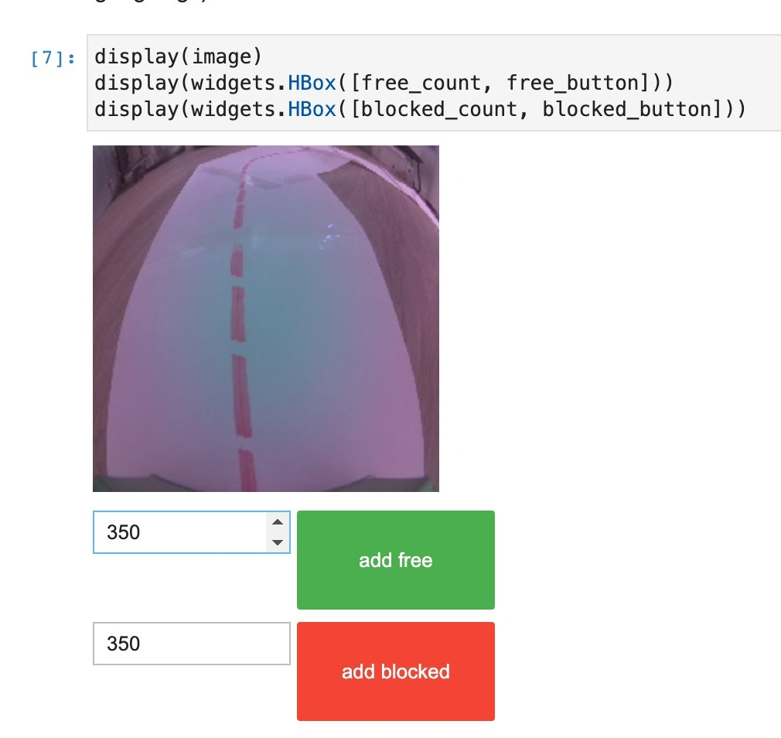
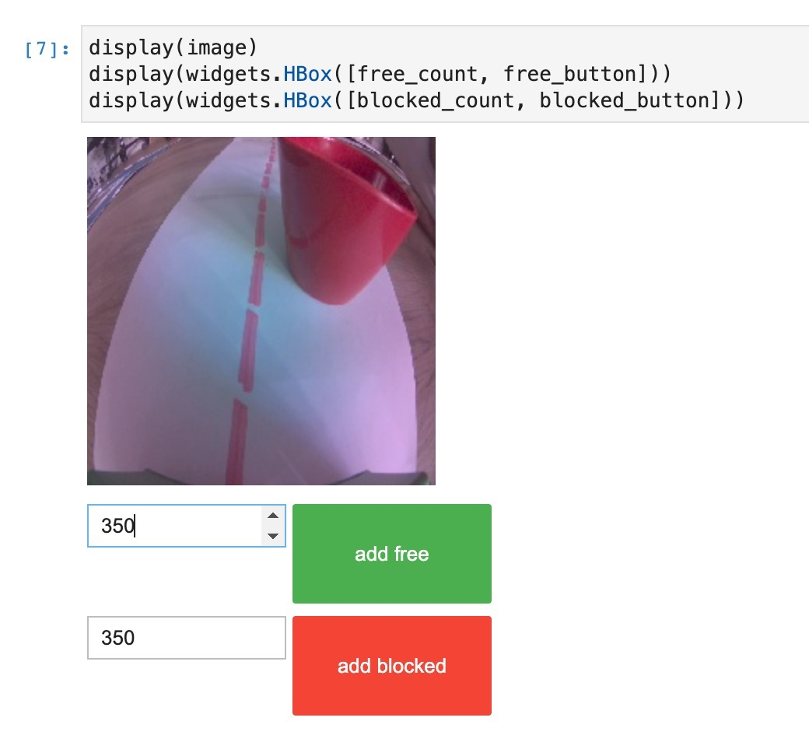
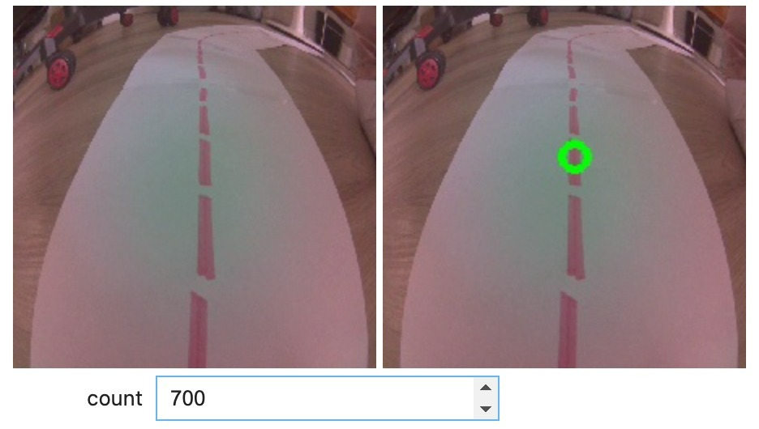
Collision Avoidance
Road Following

Slide 4
02
Road Following
In this section, will be using Deep Neural Network based models to train our Jetbot to follow a road.

Slide 5
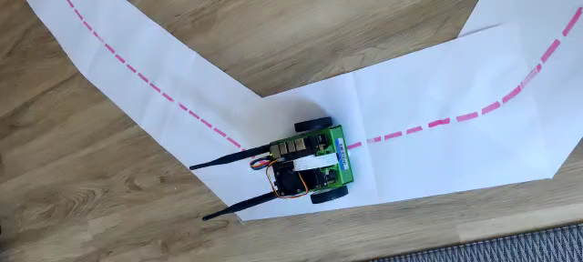
Road Following

Slide 6
03
Collision Avoidance
In this section, will be combining both optimized regression and classification models so that our Jetbot will be able to perform road following as well as enable collision avoidance at the same time so that it can avoid collisions with obstacles that come on its way in real-time.

Slide 7
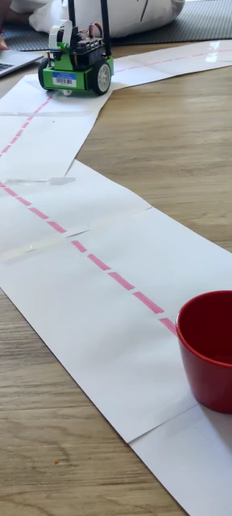
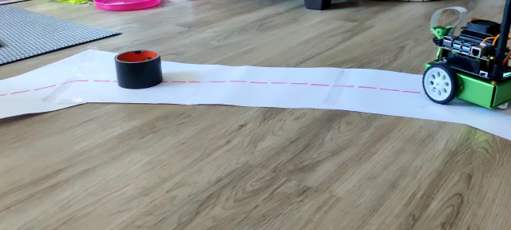
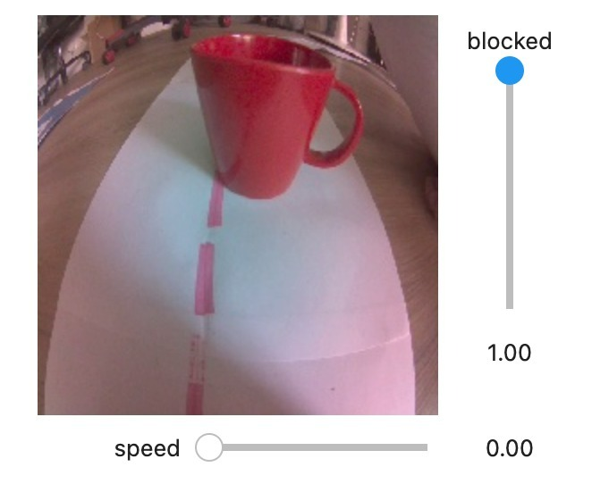
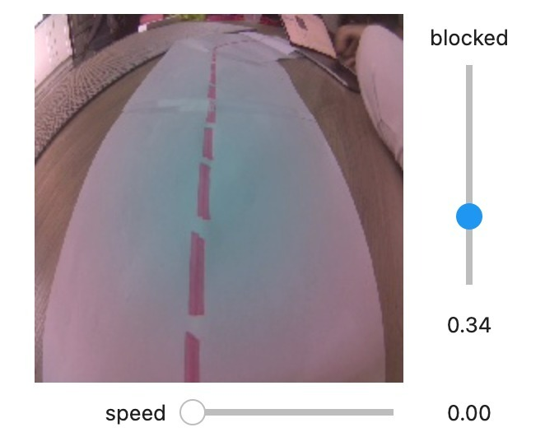
Collision Avoidance

Slide 8
04
Object Following
In this section, we will be using pre-trained models on Coco dataset and teach our jetson nano bot to follow various objects (person, car etc.)

Slide 9
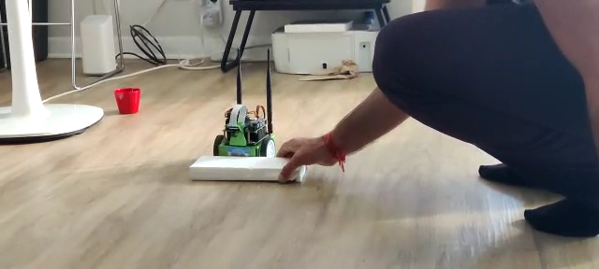
Object Following…

Slide 10
05
Challenges, Issues & Difficulties
In this section, we will talk about various challenges and issues faced during this project.
We will also mention how we were able to solve all the challenges.

Slide 11
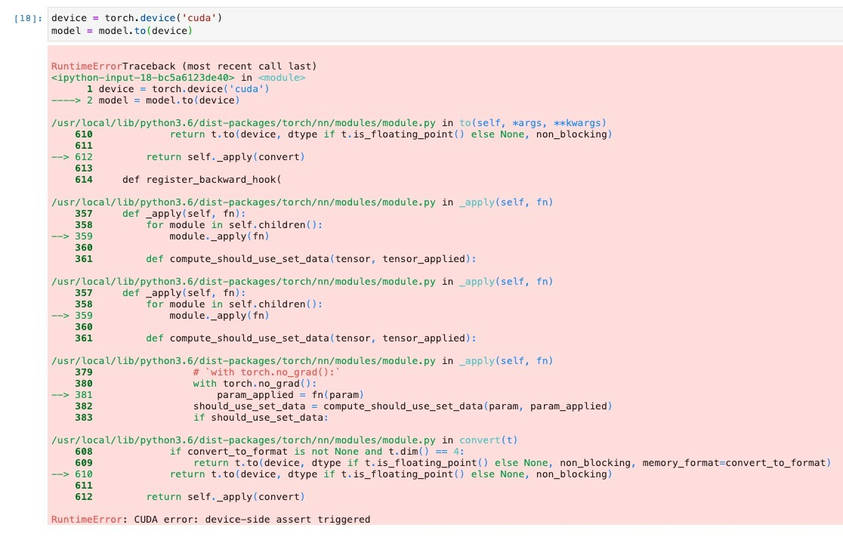
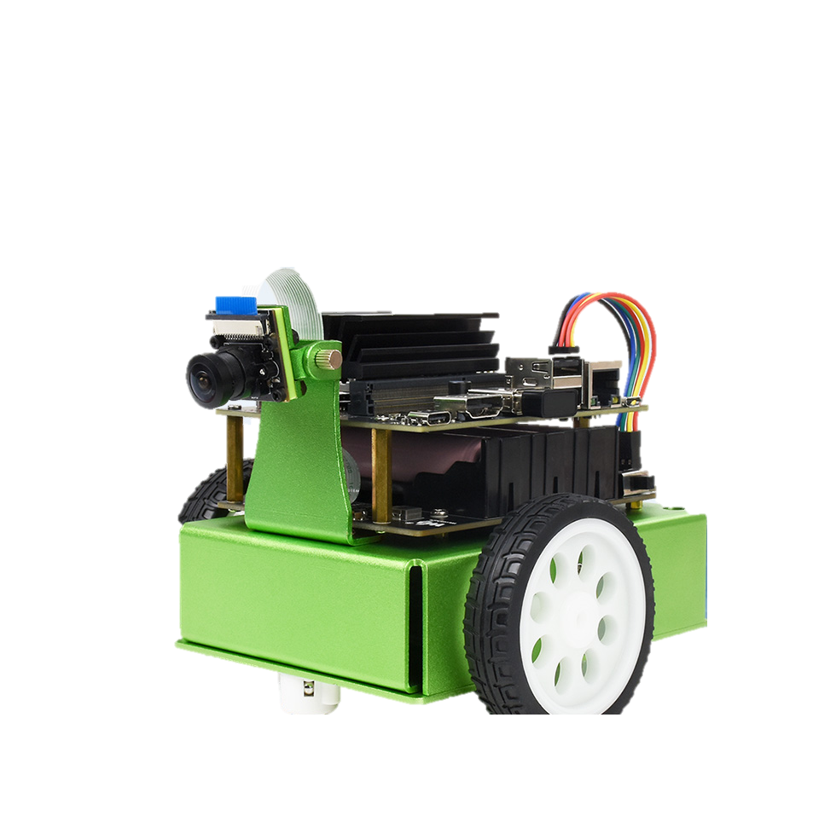
Cha
Challenges | Solution
Error while training the model (CUDA error: device-side assert triggered) | It turns out that there are hidden files ".ipyxxxx" under dataset folder and its sub-folders. These hidden files can't be seen on the browser jupyter notebook. So we deleted all the hidden files under the dataset, We uploaded the cleaned dataset.zip to jetbot. The error is gone. Moreover, we also Reinstalled Jetpack v4.3
Jetson Nano moving in circles only, and was unable to follow the road and avoid objects | Updated the configurations in the code: Ensured Jetson Nano speed was set to the lowest possible level, Steering kd was set to 0.30 Streeing gain was set to 0.01

Slide 12
Cha
Challanges | Solution
Jetson Nano wasn't performing well (unable to follow the road) on Track | We tried training the model with more images, better lighting, and different orientation
Servo motors in the Jetson Nano were faulty and due to this the Jetson Nano was unable to move in a straight/forward direction | Replaced it with new motors.

Slide 13
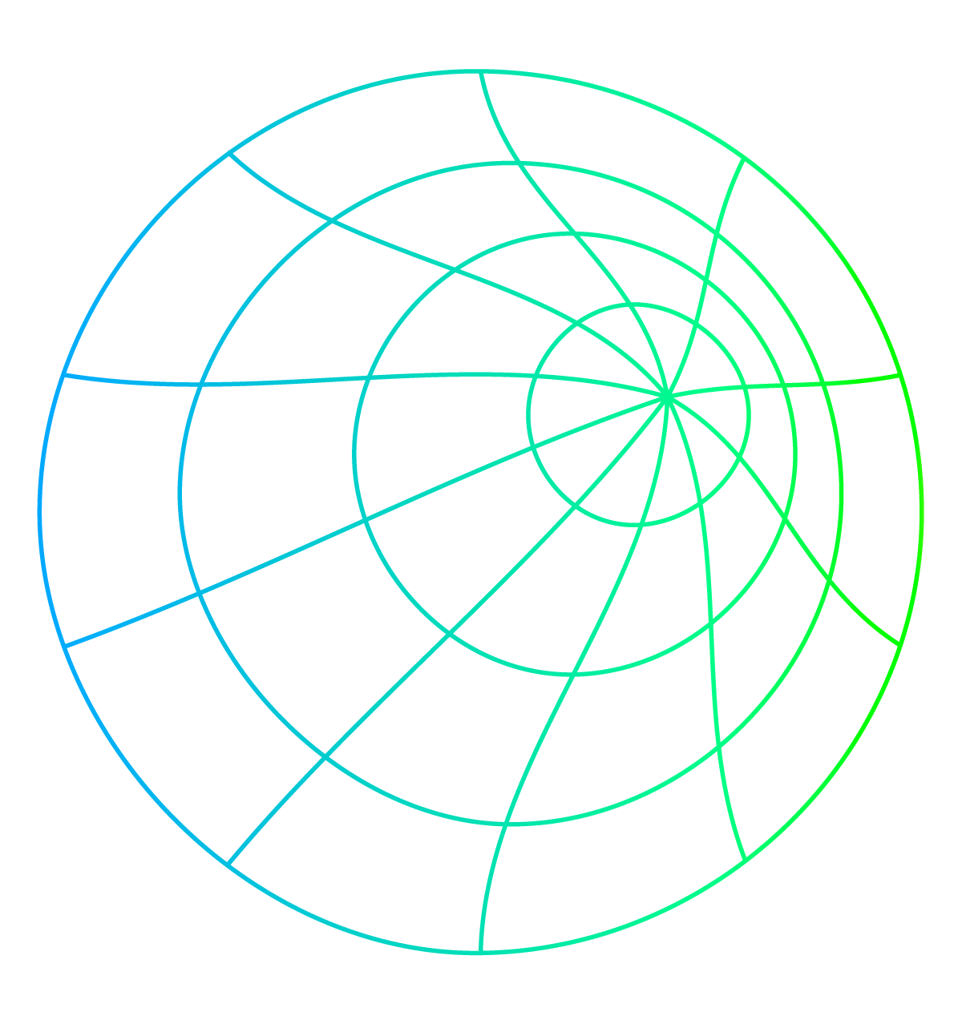
Thank You ☺

